Slide 1

Attendance Management System USING DJANGO
Smt.E.Ramalakshmi Assistant Professor.
Devarakonda Shiva Raj 160119737171
Venkateshwara Akhil 160119737178

Slide 2
OBJECTIVE
The Attendance Management System Django is developed using Python Django, HTML,CSS, JavaScript .
This Django Attendance System contains the teacher side and the student side, the teacher can manage the attendance, marks and can generate the reports of the students, and the students can view their attendance, marks and the time table of their class schedule.

Slide 3
INTRODUCTION
As we know that, a college consists of different departments, such as course departments, fees management, library, event management etc. Nowadays applications and uses of information technologies is increased as compared to before, each of these individual departments has its own computer system to do their own functionalities.
By having one main system they can interact with each other from their respected system by having valid user id and password

Slide 4
PURPOSE
The purpose of developing attendance management system is to computerized the tradition way of taking attendance. Another purpose for developing this software is to generate the report automatically at the end of the session or in the between of the session

Slide 5
WHY ERP?
Nowadays, in schools and colleges, it is very difficult to manage each and everything manually. Supervising and maintaining the whole database of a school or college can be time-consuming and challenging especially if it’s done on a regular basis. So, we need to handle and manage everything smartly.
Prominent roles of ERP are:
• Manages the office and automates different functions.
• Helps in long-term management and planning of all departments of college.
• Eliminates the need for having multiple management software for each department.
• Daily activities like attendance can be digitalized and automated.
• Leave module for teachers can be automated.

Slide 6
PROBLEM DEFINITION
This system developed will reduce the manual work and avoid redundant data. By
maintaining the attendance manually, then efficient reports cannot be generated manually.The system can generate efficient weekly,consolidate report based on the attendance.
As the attendances are maintained in registers it has been a tough task for admin and staff to maintain for long time. Instead the software can keep long and retrieve the information when needed.

Slide 7
FEATURES
• Each teacher will be able to enter attendance and marks for their respective students.
• Each student will be able to view the attendance status for their respective courses.
• The teachers will be able to apply for various types of leave directly through the system.
• The students will be able to Communicate and provide feedback to their teachers.
• The students will have access to a forum page where they are communicate will each other.
• The administrator will be able to view and update information such as departments, classes, teachers, students, courses

Slide 8
SOFTWARE REQUIREMENTS
-We Have Used Python Django ,HTML,CSS and Javascript for making this website.
-For saving the data of students we have used SQLite database.
-To Access this website we can use any type of internet explorer.
• Web Browser: To run server (eg: Google chrome,Microsoft Edge)
• Django: Framework used in this project
• Pycharm: IDE used in this project which runs on python
• Python 3.7.6: Python version

Slide 9
HARDWARE REQUIREMENTS
Internet Connection With Good Speed
Operating system: Windows,Mac OS ,Linux
Graphics : Intel or Nvidia
Hard drive: 5 Giga Bytes
CPU- Single Core 2.4ghz
Network : Broadband Recommended
RAM:512 MB

Slide 10
ADVANTAGES OF PROPOSED SYSTEM
1. It is trouble-free to use.
2. It is a relatively fast approach to enter attendance
3. Is highly reliable, approximate result from user
4. Best user Interface
5. Efficient reports

Slide 11
MODULES
Attendance Management System basically has three main modules for proper functioning
• First module is admin which hold the key for editing and updating information. The admin has absolute right to all the users which are the Teachers and Student.
• Second module is handled by the user which can be a Teacher or Instructor. This user has a right of making daily attendance, updating, editing and generating reports to the students.
• Third is handled by a user which is the Student, he has less privilege to the access of the system; the student can only view his own record by providing his username and password

Slide 12
USER CLASSES
The student should have the following features:
• View the Attendance status of the courses to which they are enrolled.
• View the Marks of the courses to which they are enrolled.
• View the notification from the college administrator.
• Communicate or give feedback to their respective teachers.
• Communicate with other students of the same university.
The staff should have the following features:
• Access to the information of all students that attend their courses.
• Add and edit the Attendance status of those students.
• Add and edit the exam marks of those students.
• Avail the different types of leave.
• Swap classes with other teachers who teach for the same class.
The administrator should have the following features:
• Add and update students, teachers and courses.
• Assign teachers and students to courses

Slide 13
VIEWPOINTS
For a teacher, this software must be easy to use. It should be easy to find different modules like attendance, leave module, internals marks, result etc...Teachers are the one who update the contents of the database, so it should be update save modify It.
A student can only view the information about himself, other than that everything will be hidden from them. They will not have the option to edit anything. So the graphical user interface must be good. They expect it to be functional.
Administrator will have the privilege to view all the information about the college. They will have the option to track goals like, Average marks of all the students in a subject, Average attendance of all the students of a class etc.

Slide 14
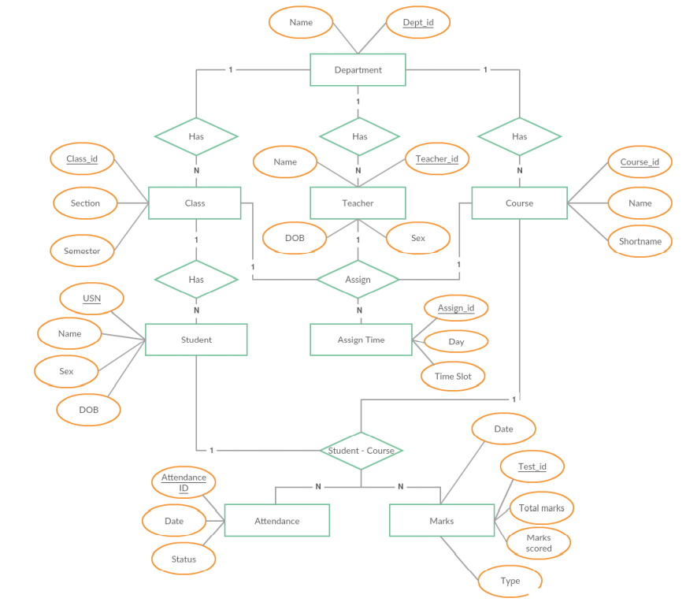
ER DIAGRAM

Slide 15
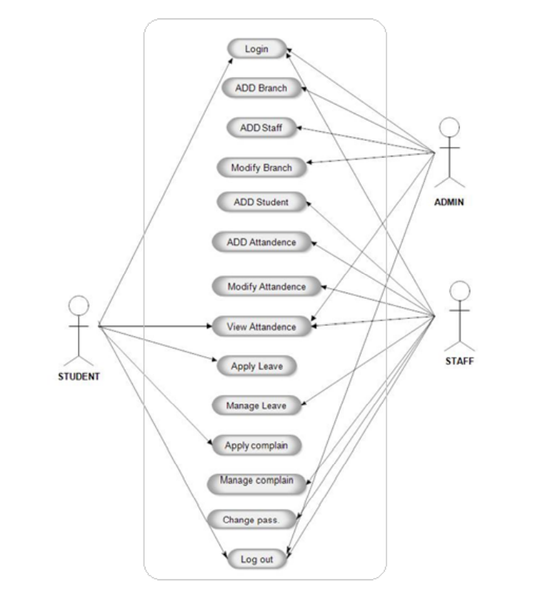
USE CASE DIAGRAM

Slide 16
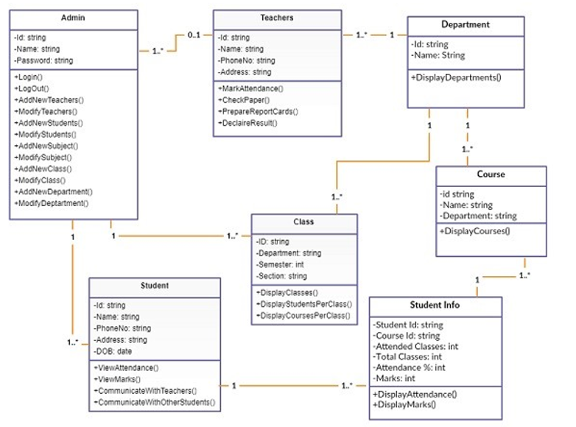
CLASS DIAGRAM

Slide 17
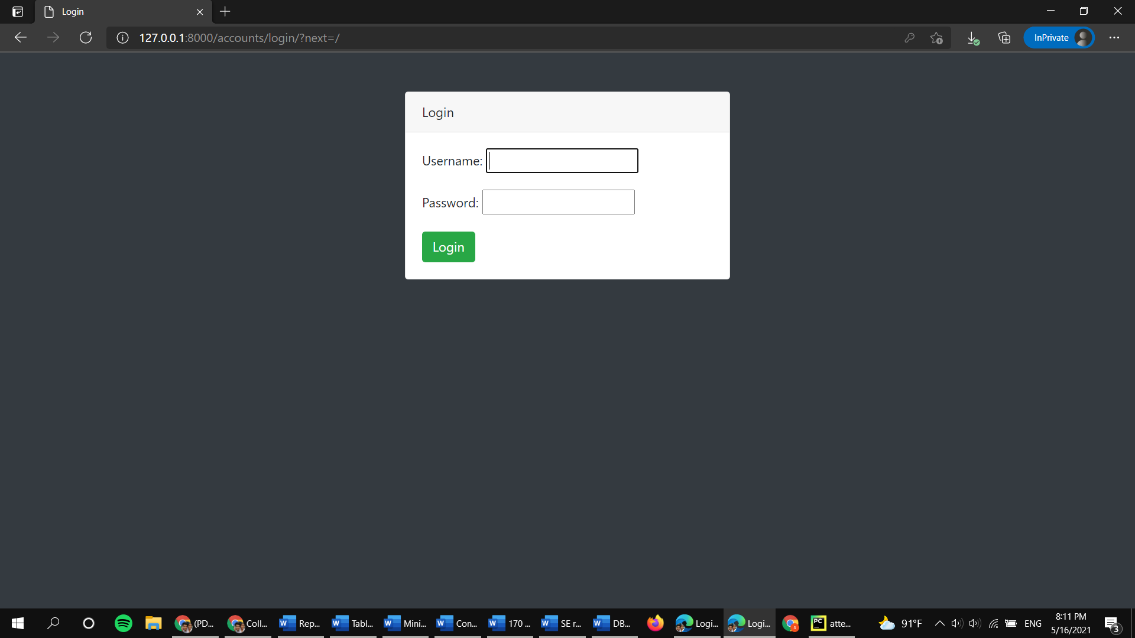
LOGIN PAGE

Slide 18
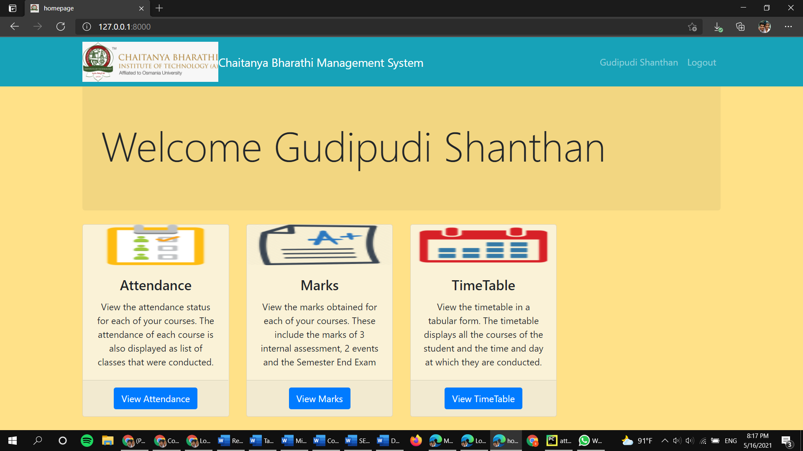
STUDENT HOMEPAGE

Slide 19
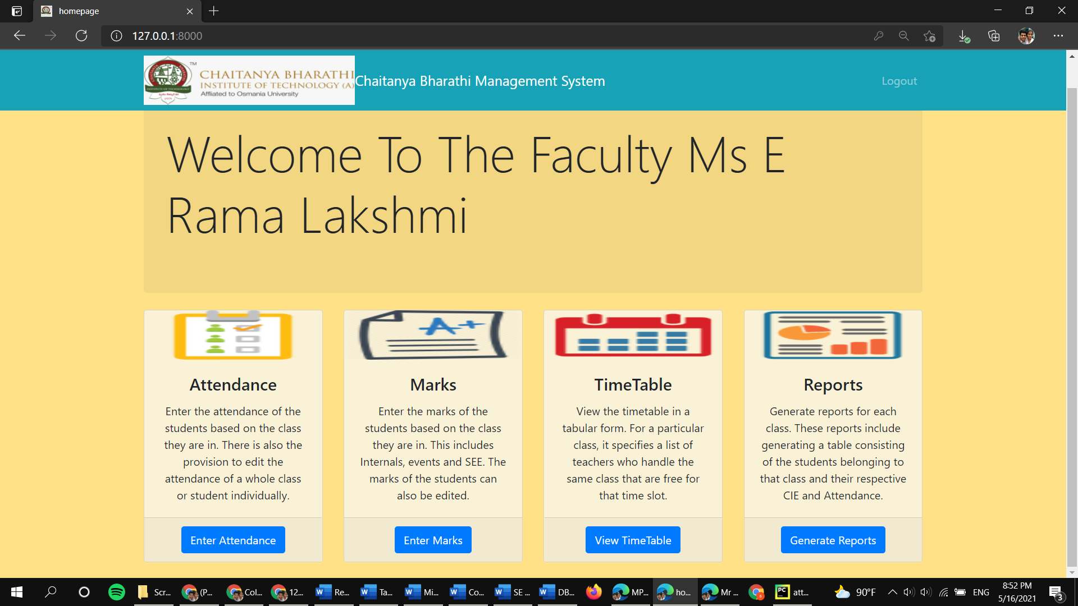
TEACHER HOMEPAGE

Slide 20
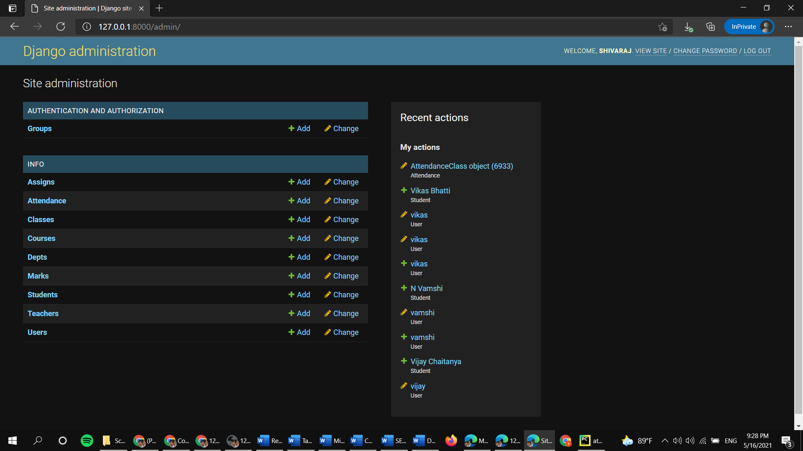
ADMIN HOMEPAGE

Slide 21
CONCLUSION
Attendance Management System , a web based application, has been developed and proved on helping school management to manage student attendance. The development design is using context diagram to show overall task of each user and Entity relationship diagram to show relationship between database tables.

